Slide 1
International Law: Global Trade
Shamshad A. Khan, PhD
Assist. Prof.
HSS BPDC

Slide 2
Global Trade and Finance: Emergence of a system
General Agreement on Tariffs and Trade (GATT) signed in 1947 played an important role in formulating and shaping post war global trade policies.
GATT was a legal agreement minimizing barriers to international trade by eliminating or reducing quotas, tariffs, and subsidies.
The GATT was intended to boost economic recovery after World War II through reconstruction and liberalizing global trade.

Slide 3
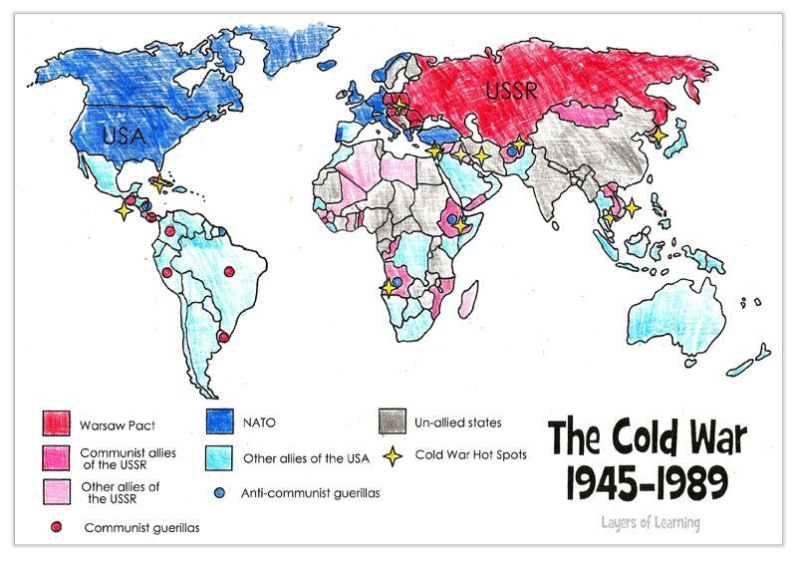
Global Trade during the Cold War
The world was divided into Socialist and Capitalist camp (the ideological divide impacted the trade as well)
Trade between countries and across the border had restrictions. (High tariff, high tax on foreign country’s industry and their products:)
End of the Cold War in 1990, changed and galvanize international trade.
This led to GATT transforming into WTO. (1995)

Slide 4

How the countries regulated trade before WTO (Various Protectionist Measures)
Import prohibition: Various goods were not accepted from foreign countries to protect indigenous/local industry or Sectors (-Ve list)
Import Quotas: If things were imported from outside of the border, the numbers of the imported goods were fixed. (Measure to protect local industry)
Tariffs: The states imposed high tariff (tax on imported goods). Intended both to gain revenue as well as protect industry.
Discriminatory Policies: different regulations and taxes for local and foreign industry
Subsidies: The govts gave incentives, partly bearing production costs.
Donald J. Trump
@realDonaldTrump
When a country Taxes our products coming in at, say, 50%, and we Tax the same product coming into our country at ZERO, not fair or smart. We will soon be starting RECIPROCAL TAXES so that we will charge the same thing as they charge us. $800 Billion Trade Deficit-have no choice!
5:57 PM · Mar 2, 2018
Tweet
See new Tweets
Conversation
During a discussion with members of the Congress on the steel industry, Trump said the recent decision of the Indian government to reduce the tariff from 75 per cent to 50 per cent was not enough and asked that it should be reciprocal, as the US imposes "zero tax" on the import of motorcycles.
https://www.outlookindia.com/website/story/donald-trump-slams-india-for-high-import-tax-on-harley-davidson-bikes-threatens-/308291

Slide 5
International Trade law after WTO
WTO formed in 1995, is successor of General Agreement on Trade and Tariff GATT of 1947.
Only international organization dealing with the global rules of trade between nations.
Main function is to ensure smooth and free flow of trade (trade in goods and services).
WTO’s rules discourages protectionism.
Encourages members to provide Most Favoured Nation (MFN) and National Treatment to member countries. (Elaborate)

Slide 6
WTO Treaty Provisions
Tariffs would be reduced on over 80% of the world trade.
Dumping goods on another countries market at below-cost prices to eliminate that country’s domestic producers would be banned.
Farm subsidies that artificially make one nation’s domestic producers more competitive would be reduced, and quotas on imported textiles would be phased out.
“Piracy” of copyrighted books, films, music, and other intellectual property would be punished.

Slide 7
MFN and its legal aspect
WTO’s MFN rule specifies that a product or service coming from one WTO member should be treated equally.
“Under the WTO agreements, countries cannot normally discriminate between their trading partners. Grant someone a special favour (such as a lower customs duty rate for one of their products) and you have to do the same for all other WTO members.” WTO
Each member treats all the other members equally as “most-favoured” trading partners.
If a country improves the benefits that it gives to one trading partner, it has to give the same “best” treatment to all the other WTO members so that they all remain “most-favoured”.
India allows vegetable oil import at lower duty until March 2024
https://economictimes.indiatimes.com/news/economy/foreign-trade/india-allows-vegetable-oil-import-at-lower-duty-until-march-2024/articleshow/96618121.cms?from=mdr

Slide 8
National Treatment
WTO also has National Treatment principle.
This means treating local and foreign investors and their products equally. (Once it enters into its market)
No preference to local investors/goods over the foreign investors/goods in terms of taxes or concession etc.
chrome-extension://efaidnbmnnnibpcajpcglclefindmkaj/https://www.wto.org/english/res_e/booksp_e/dispu_settl_1995_2012_e.pdf

Slide 9
Tariff and the global trade
While earlier, the states used to put high tariffs on imports, the WTO encourages the members to lower tariffs and also announce the rate of tariffs on a particular product.
http://www.customs.go.jp/english/tariff/2019_4/data/e_07.htm
( Explain)
Example: if a country import steel from abroad, it has to announce a tariff, let's say 10% of the products’ base price , it must levy the same tariff from all the exporting countries. (No different tariff on India’s and China’s steel imported into UAE) (except if you have an FTA with a particular country.)

Slide 10
Some exceptions in the WTO rule: based on Standard
Member states can deny access to a good from abroad if it does not meet its Sanitary and Phyto Sanitary (SPS) measures
Each state has its own standard of SPS Measures
Example: If UAE thinks that the potatoes from India contains some fungus which could be hazardous for its citizens, it can deny its access.
Real life example:
https://economictimes.indiatimes.com/markets/commodities/from-russia-to-new-zealand-indian-fruits-face-entry-barriers/articleshow/2879797.cms?from=mdr

Slide 11
Some exceptions in the WTO rule: Based on the National Security concerns
If some imports can impact national security of the country, the state can deny or put the particular goods in –ve list
Example: India denied some of the telecommunication equipments from China, citing this clause.
https://gadgets360.com/telecom/news/indian-security-agencies-concerned-about-zte-managing-airtel-4g-network-253490
And more recently:
India joined a growing list of countries including the US, UK and Australia that have banned Huawei from providing 5G technology for their respective wireless networks over security concerns.

Slide 12
Some Exception in the WTO rule: Based on FTA
The states may have a separate tariff (lower than a commonly announced tariff) if they sign Free Trade Agreement/ or enter a Free Trade Area.
WTO requires the members to limit the FTAs to a “region”.
The original idea was to integrate the regional economy. Such as NAFTA, SAFTA ( yet to be concluded), RCEP, TPP.
but the countries have also signed bilateral agreements using this exemption given by the WTO. US-Israel FTA and US-Jordan agreement does not qualify for this definition.

Slide 13
The legal remedy in International trade laws
if a member state believes that its right under the WTO has been violated by another state and it has suffered economic loss it can approach Dispute settlement Board (DSB) of WTO
DSB will examine the merits of the complaints (Ex Japan vs India on Iron products)
https://www.wto.org/english/tratop_e/dispu_e/cases_e/ds518_e.htm
If found true, it will ask the rule violating countries to change its practices, and compensate the party/parties for the economic loss
India seeks compensation for U.S. steel and aluminium tariffs at WTO: Business Standards
https://www.business-standard.com/article/reuters/india-seeks-compensation-for-u-s-steel-and-aluminium-tariffs-at-wto-118041701336_1.html
If not complied with by the guilty state, the affected state can increase tariff on some of the goods of that state to compensate its loss. (Explain)

Slide 14
Recommended reading
Reform of WTO key to regaining dispute-settling mechanism
https://www.asahi.com/ajw/articles/15207802

